Slide 1


Slide 2


Slide 3


Slide 4


Slide 5
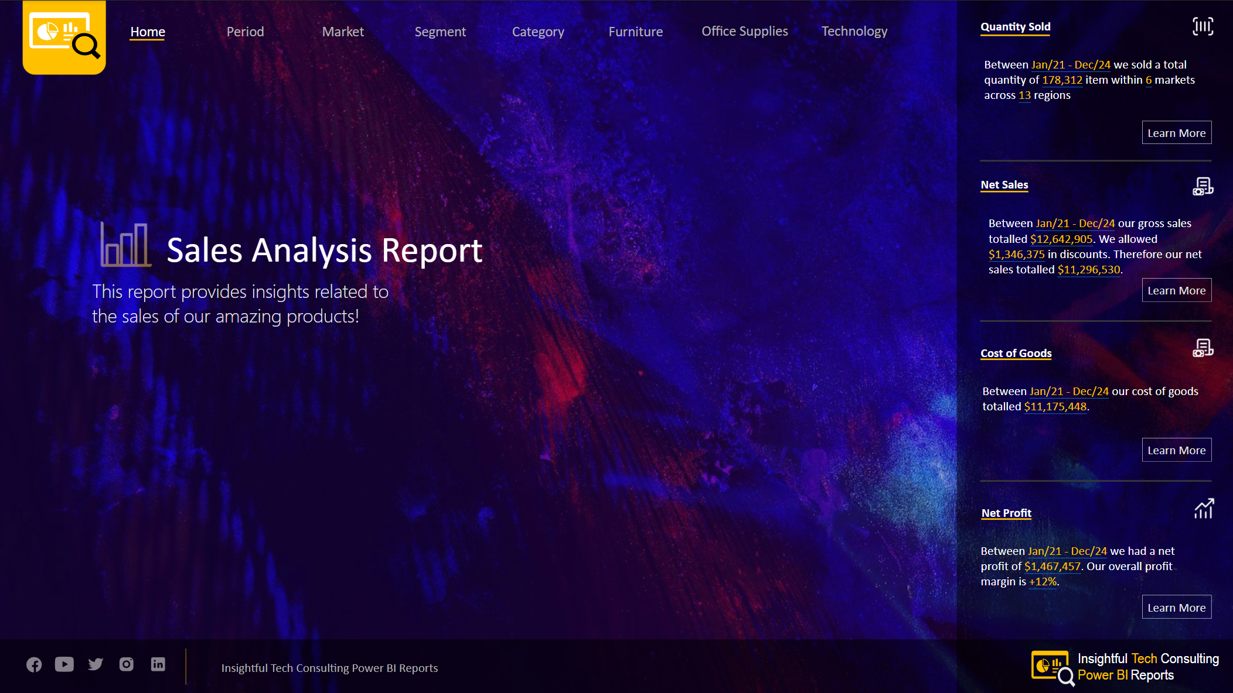
Click the items in this menu to go to the desired analysis.
Click the icons in this menu to open the selected social media link

Slide 6


Slide 7
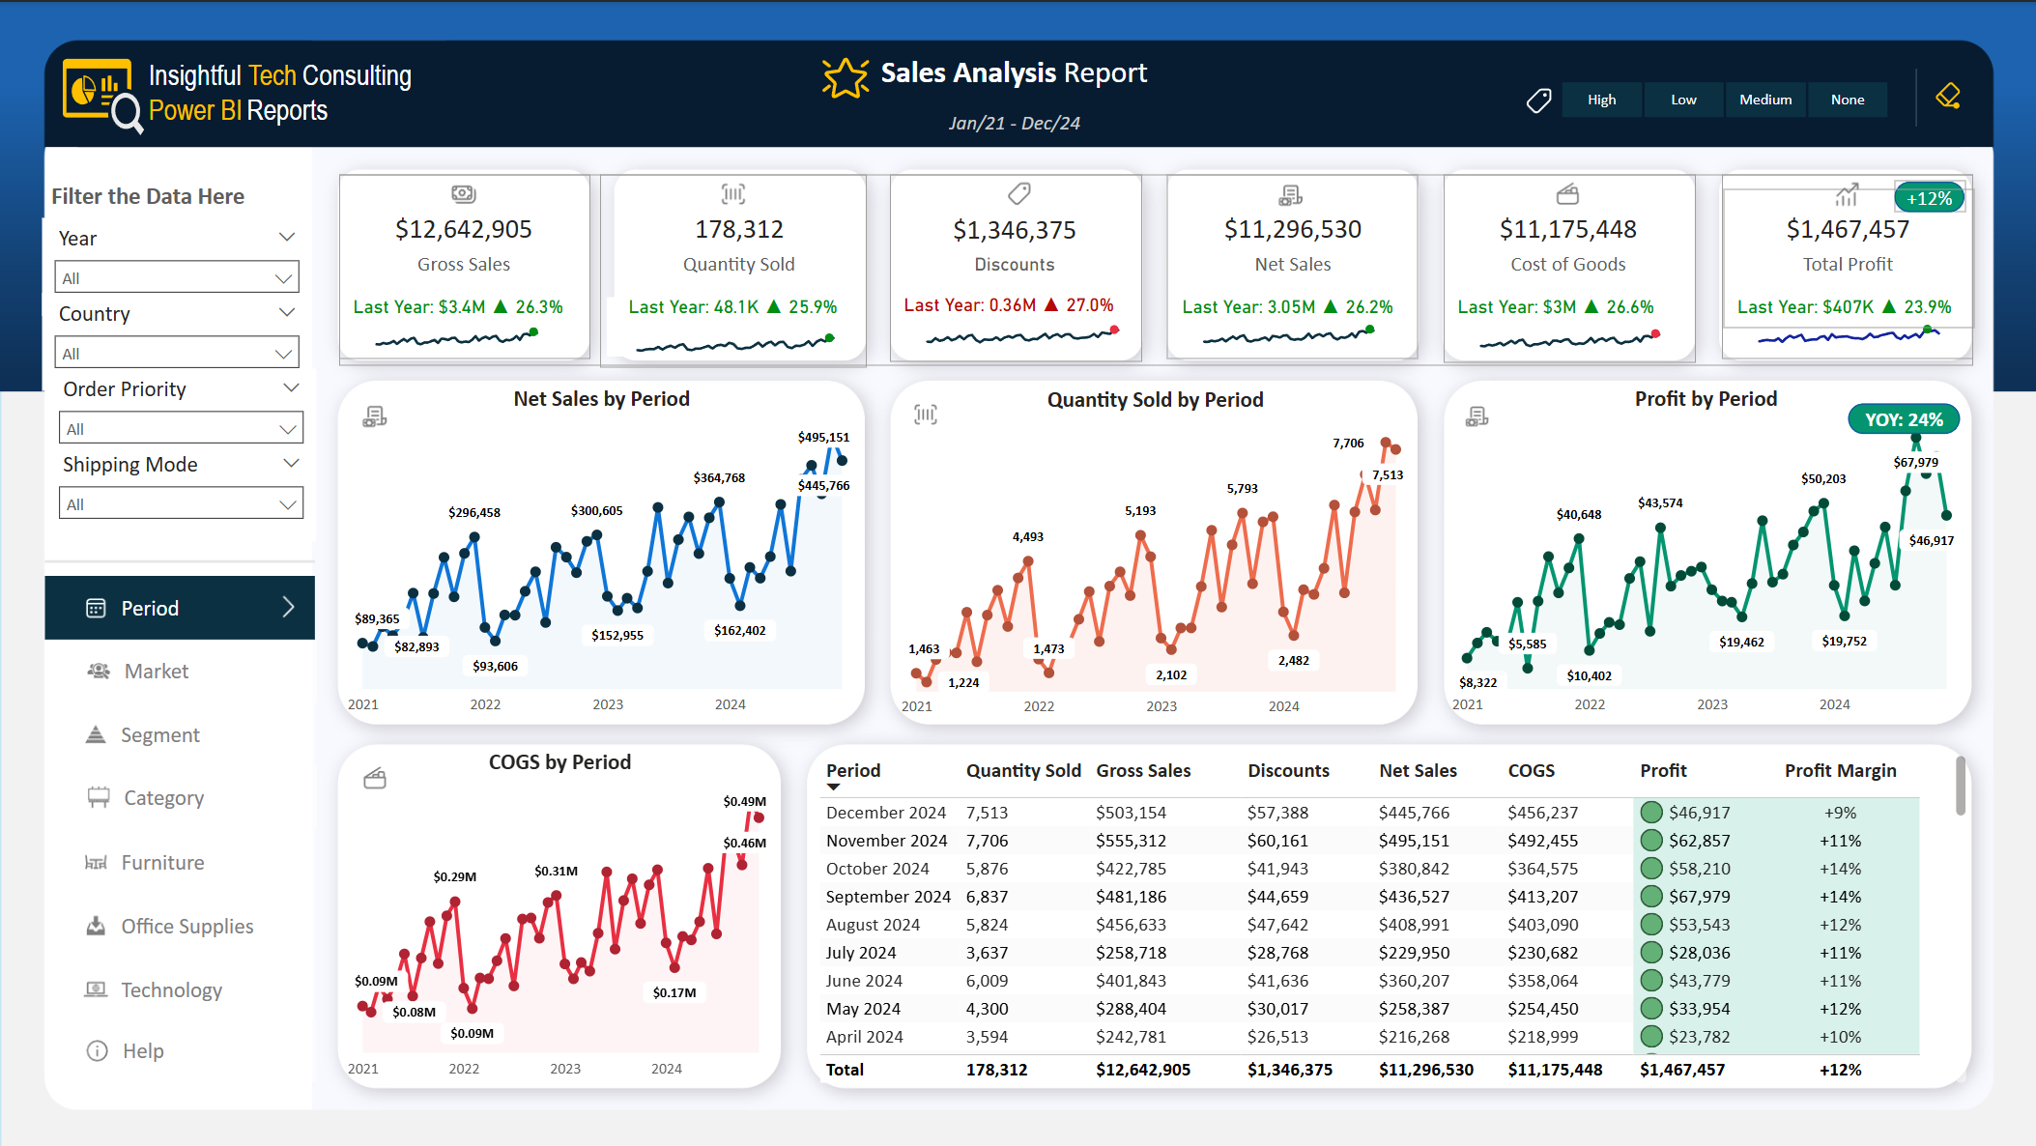
Use these filters to filter the data by the year, the country, the order priority, or the shipping mode. Click on the downward caret to open the dropdown list and click on the required value to filter the data.
Click here to filter the data by the Discount Band.
All charts have the ability when you can click on a data point or a category you will open a pop-up menu with a Drill-through option. Select this option to take you to a page that shows an analysis page for the selected data point or category.
Click on an option on this menu to go to the desired analysis or help page

Slide 10
My Version with a line showing at right hand side in Power BI

Slide 13


Slide 15
My Version which had a line showing at right-hand side of box. I fixed it by moving some things and changing their size/

Slide 16
Andrew
Hubbard
Power BI
Reports
My Logo!
This is White & Gold Text Version

Slide 17
Insightful Tech Consulting
Power BI Reports
Extra Space added between Power BI & Reports as space doesn’t show in Power BI Button
My Logo!
This is White & Gold Text Version

